Slide 1
Learning Python for Image Segmentation
By Paul McCabe
Of note: some slides have GIFs in them that only display in Slide Show mode

Slide 2
Presentation Structure
Give some background of myself
Describe the process and results of my lung segmentation approach
Outline future plans for improved accuracy

Slide 3
My Background

Slide 4
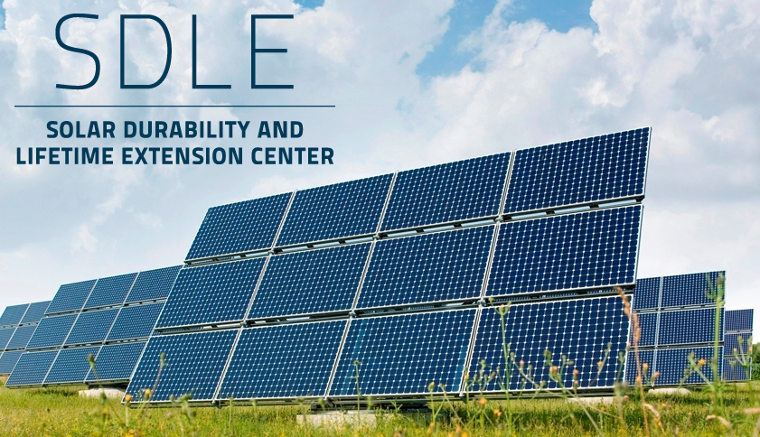
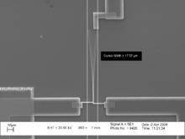
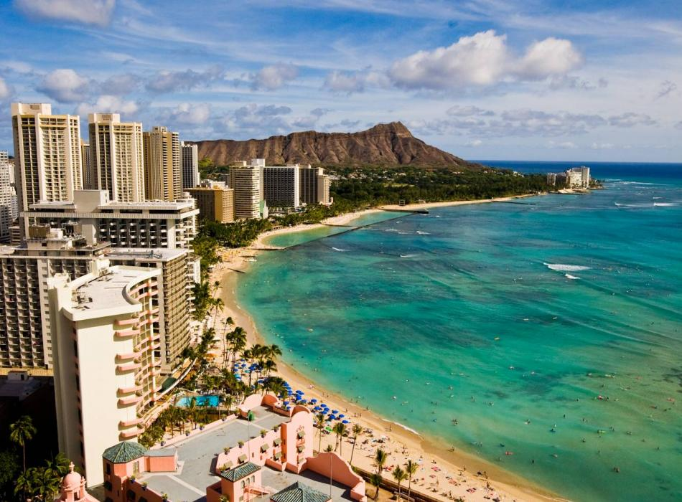
My Background
Academic Background
Rising Junior (undergraduate)
Major: Electrical Engineering & Philosophy
Personal Background
Hometown: Honolulu Hawaii
Interned at Subaru Telescope last summer
Currently developing my knowledge of machine learning and Biomedical Engineering.

Slide 5
Image Segmentation

Slide 6
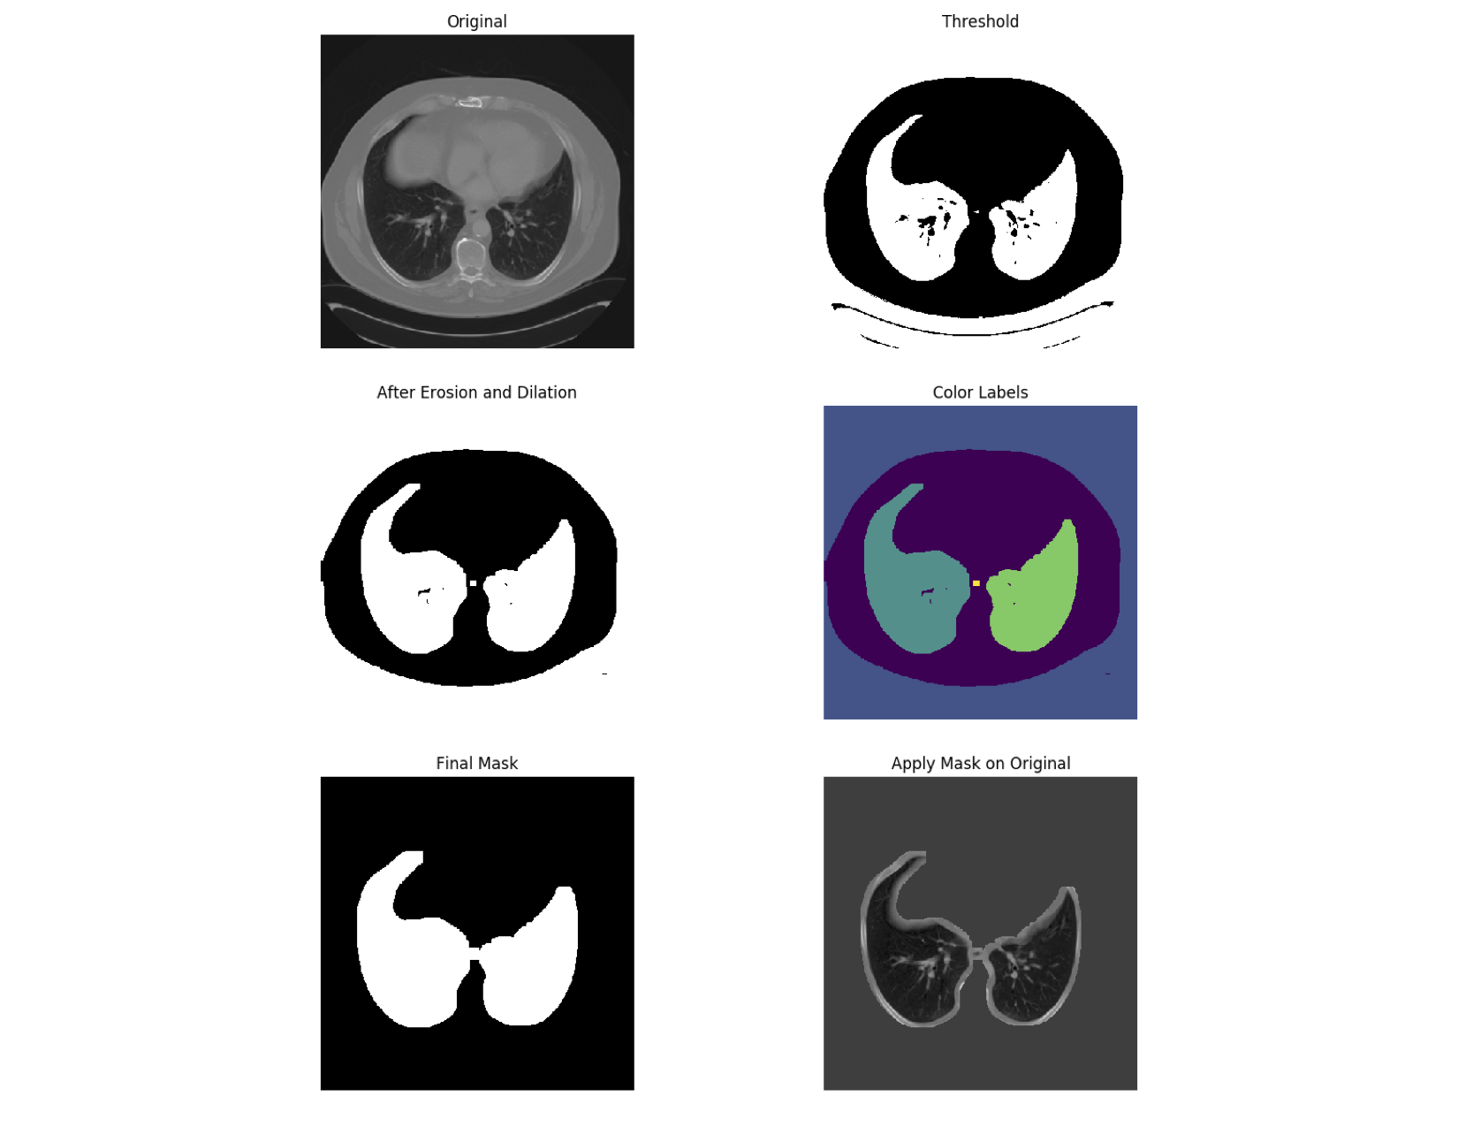
Separate Lungs
2. Threshold using KMeans
Original
3. Erode + Dilate
4. Label regions
5. Final Mask
6. Applied Mask

Slide 7
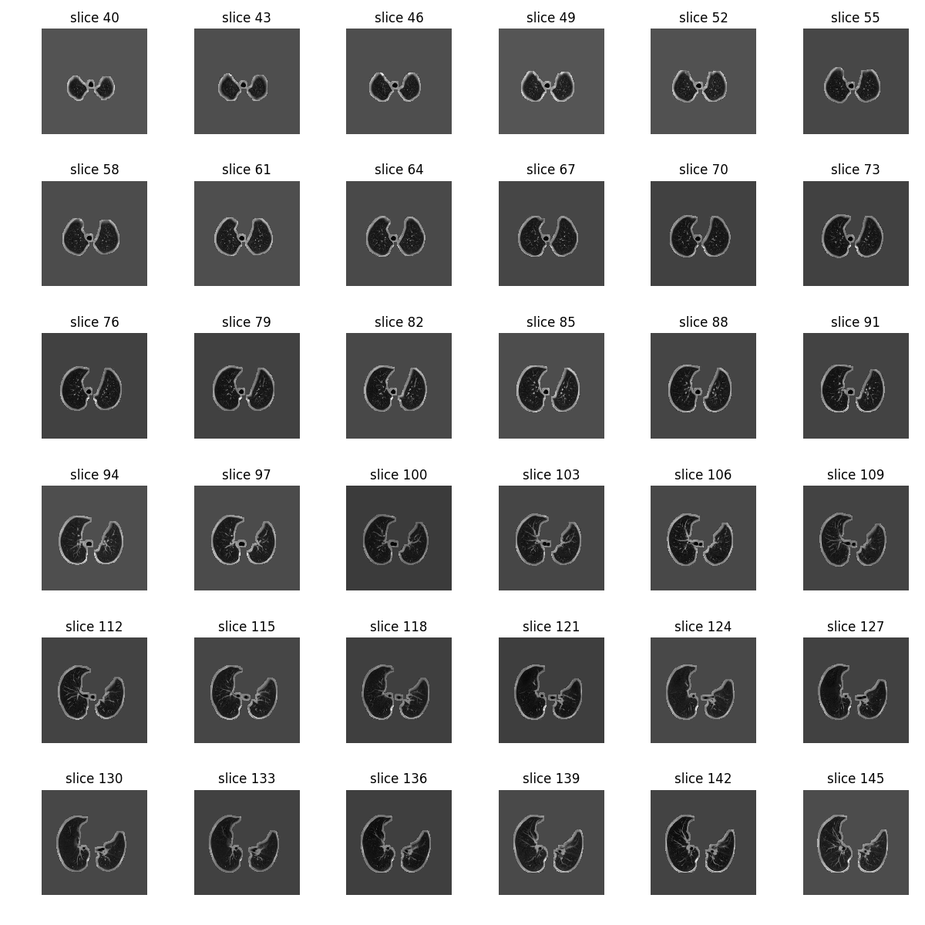
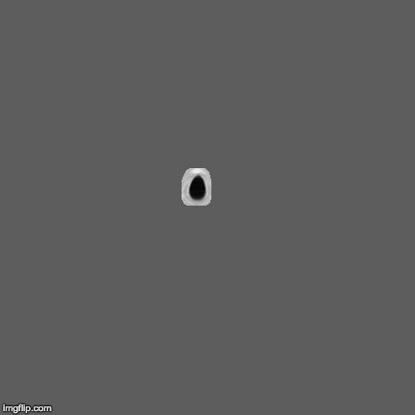
Separate Lungs
DICOM Processing and Segmentation in Python
Howard Chen, Radiology Data Quest (raddq.com)

Slide 8
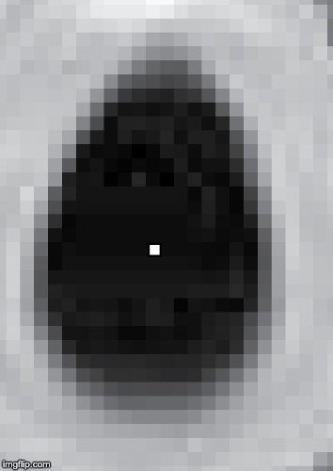

Region Grow Airway
Simple Region Growing of Airway
Seed point is calculated automatically using median position of dark area.
Growing Size: 6 voxels

Slide 9
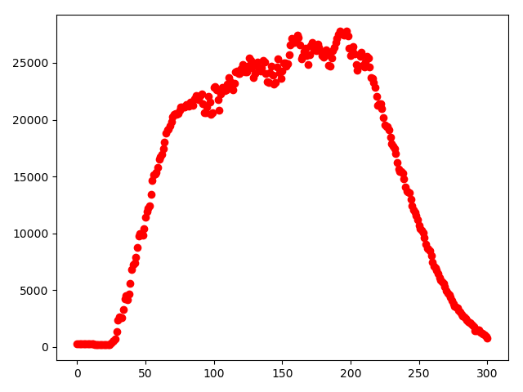
Region Grow Airway
Simple Region Growing of Airway
Leak Alert!
Pixel Count
Slice Number

Slide 10
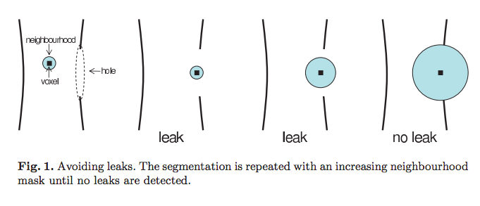
Region Grow Airway
Robust Region Growing Based Intrathoracic Airway Tree Segmentation
Rˆomulo Pinho, Sten Luyckx, and Jan Sijbers
University of Antwerp, Physics Department, VisionLab, Belgium

Slide 11
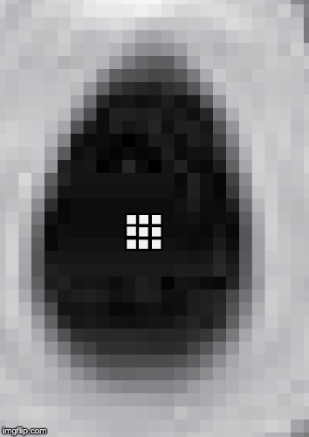

Region Grow Airway
Large Voxel Region Grower
Voxel will grow depending on how many light pixels are found in it.
If there are 3 or more light pixels in the large voxel, it will stop growing and move to another large voxel to check.
Growing Size: 26 voxels

Slide 12
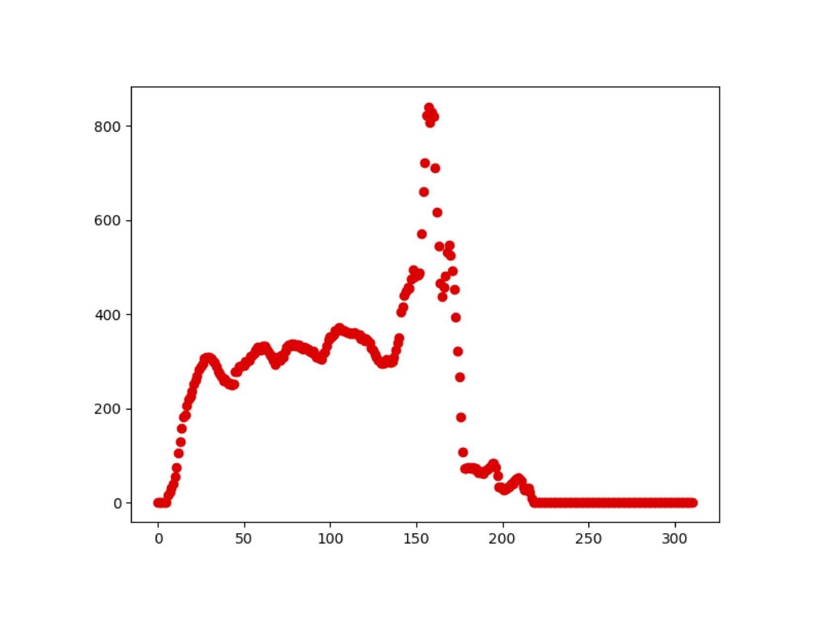
Region Grow Airway
Large Voxel Region Grower
Pixel Count
Slice Number

Slide 13
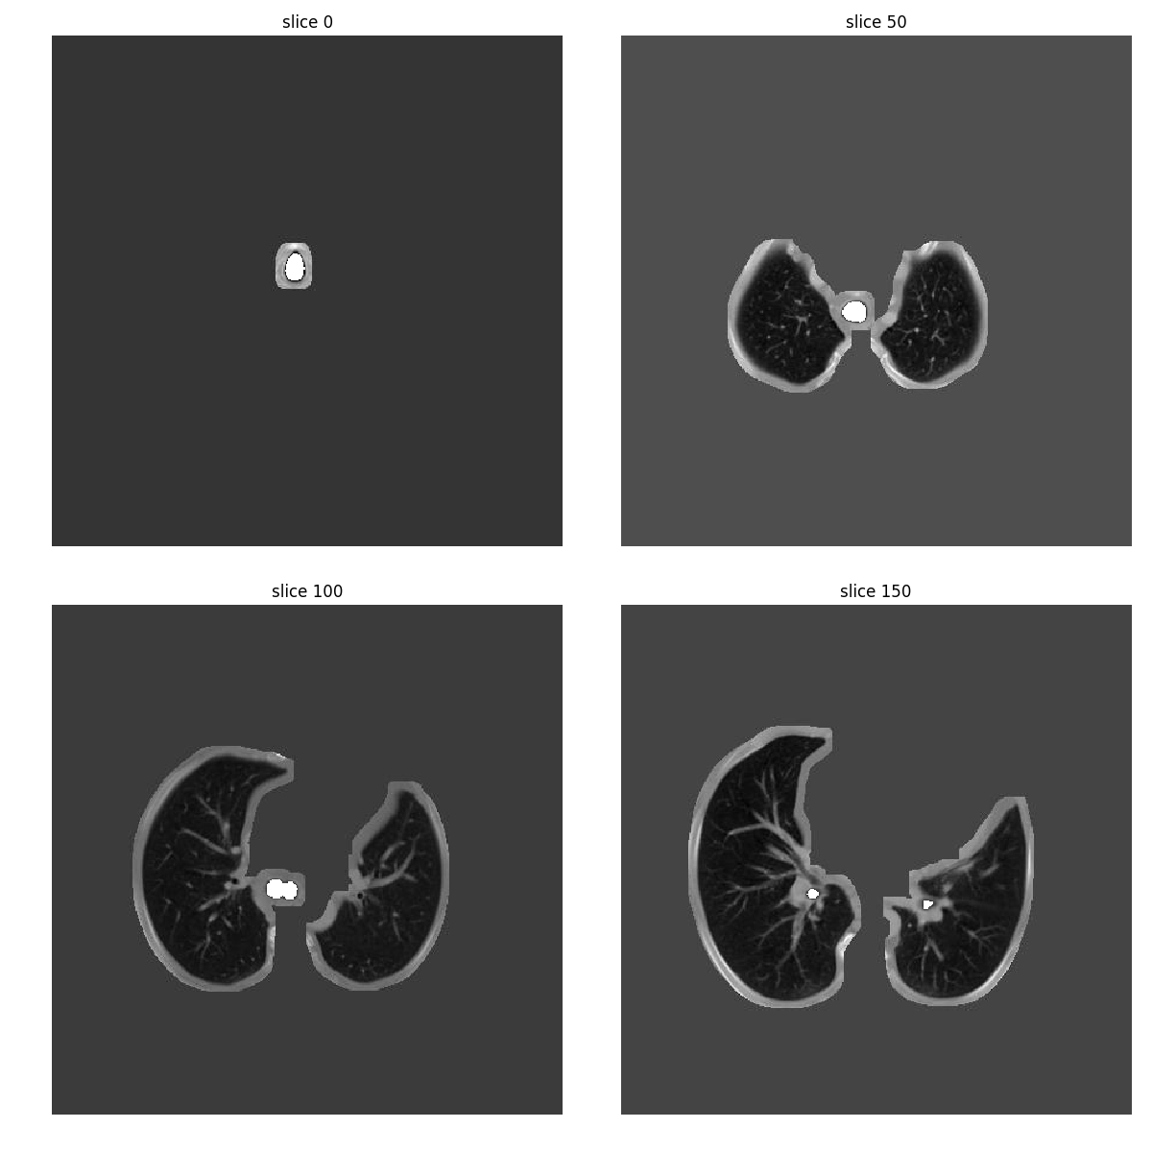

Quality Inspection
Region-Growing Area (White)

Slide 14
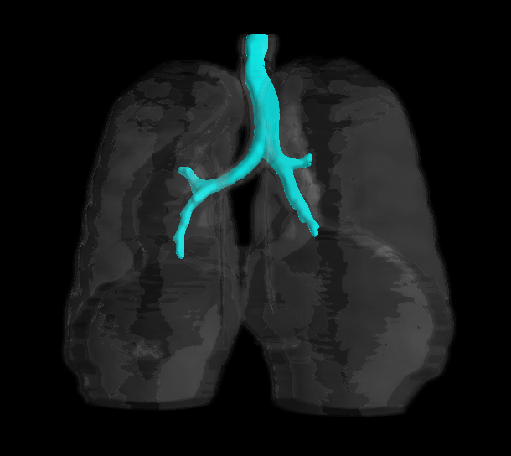
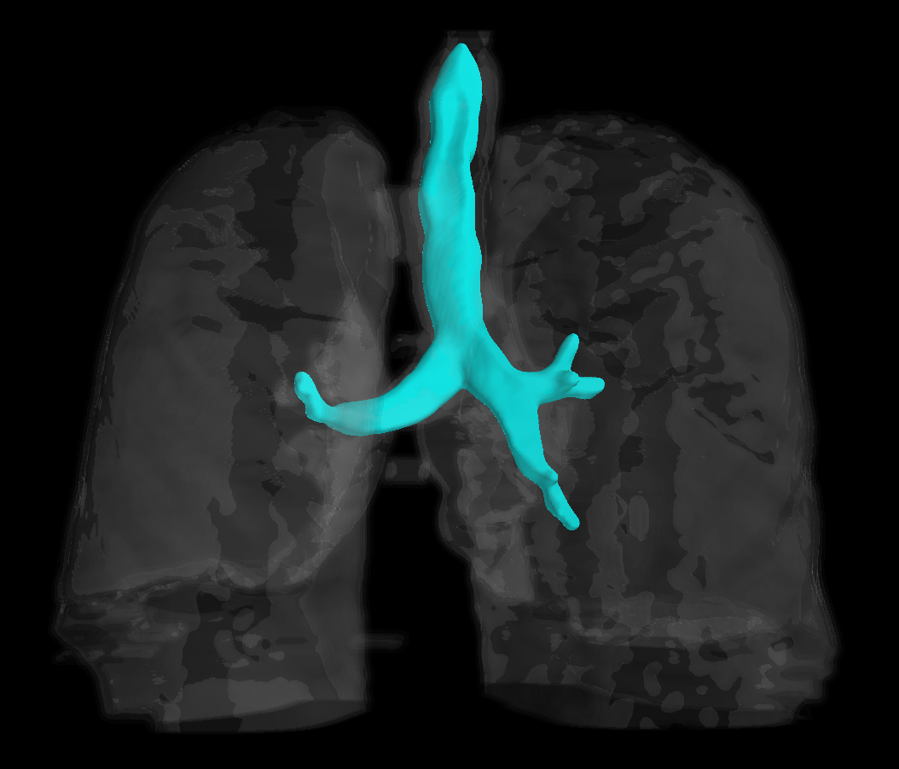
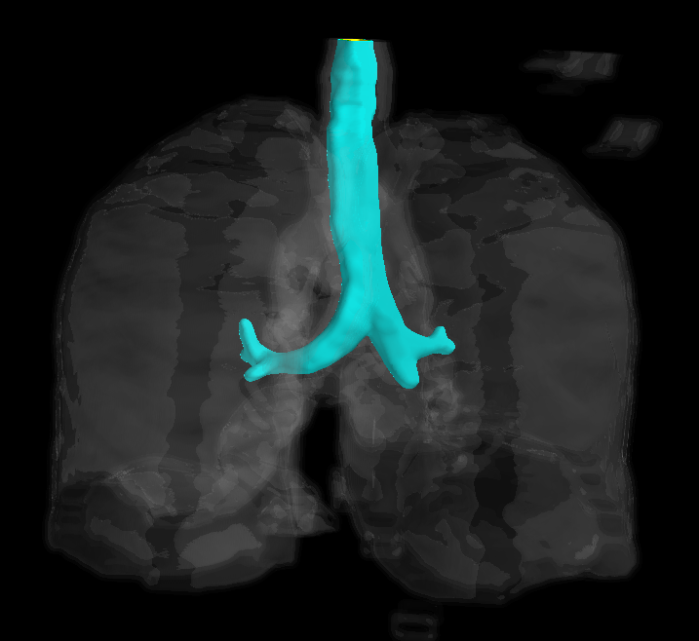
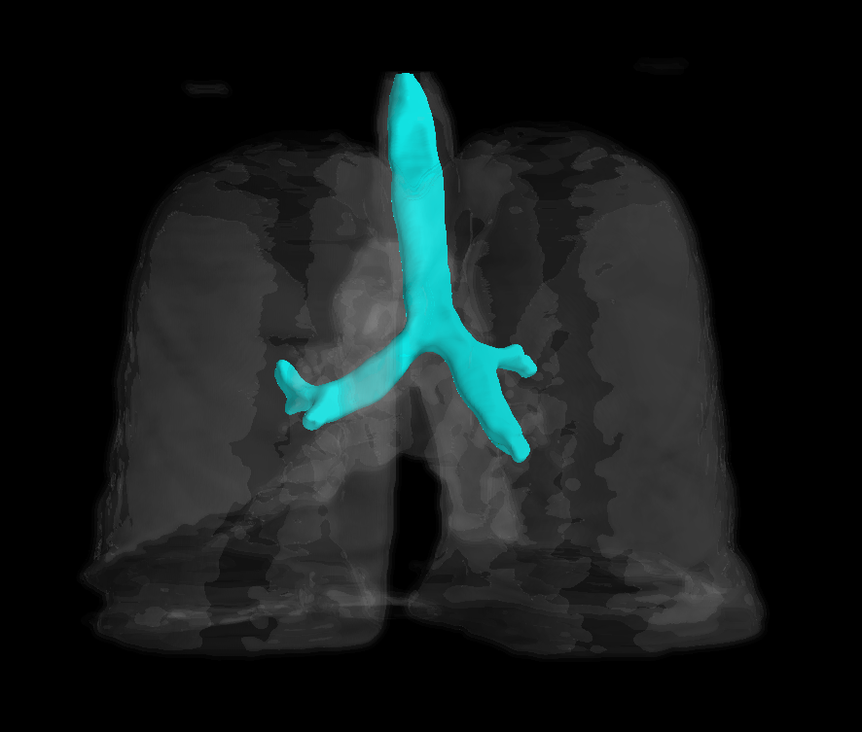

3D Modeling
Patient 1
Patient 2
Meshlab Mayavi with Gaussian smoothing filter
Surrounding lung structure
Patient 3

Slide 15
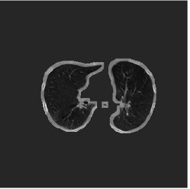
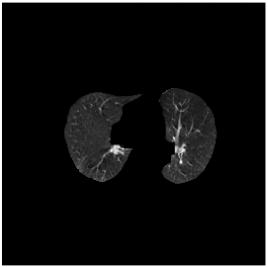
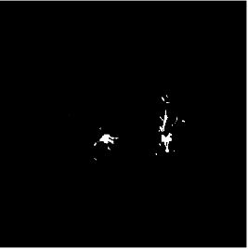
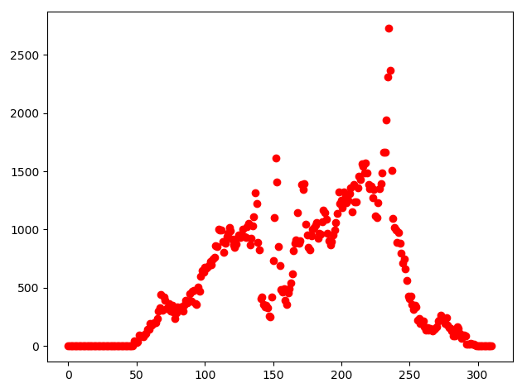
Segment Bronchioles
Lung
Edges Eroded
Simple Region Grow
1 simple region growing algorithms for each lung
Find seed point automatically using median position of light area
If seed point lands on a dark area, retry with different lightness parameters until successful
Pixel Count

Slide 16
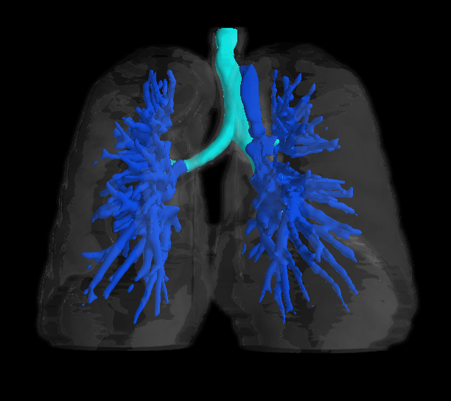
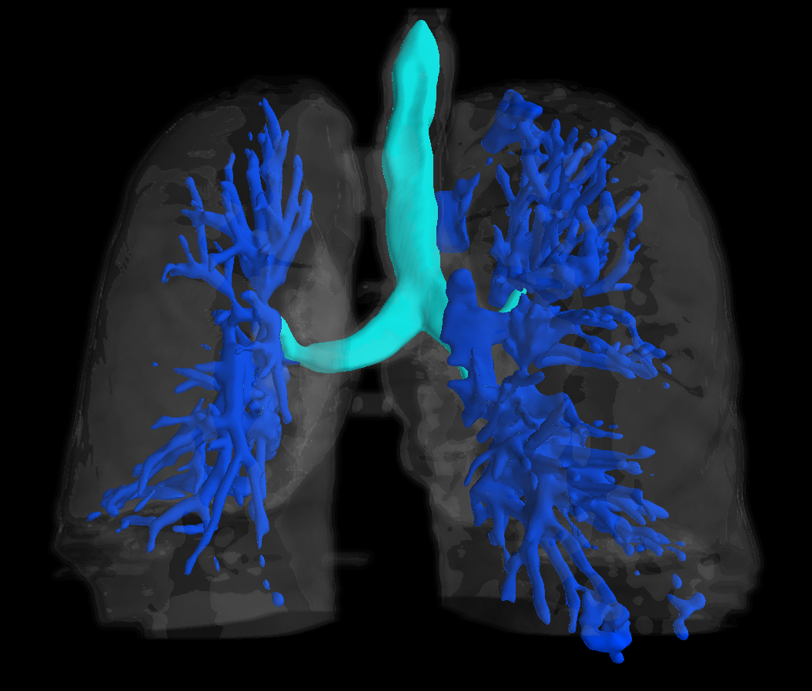
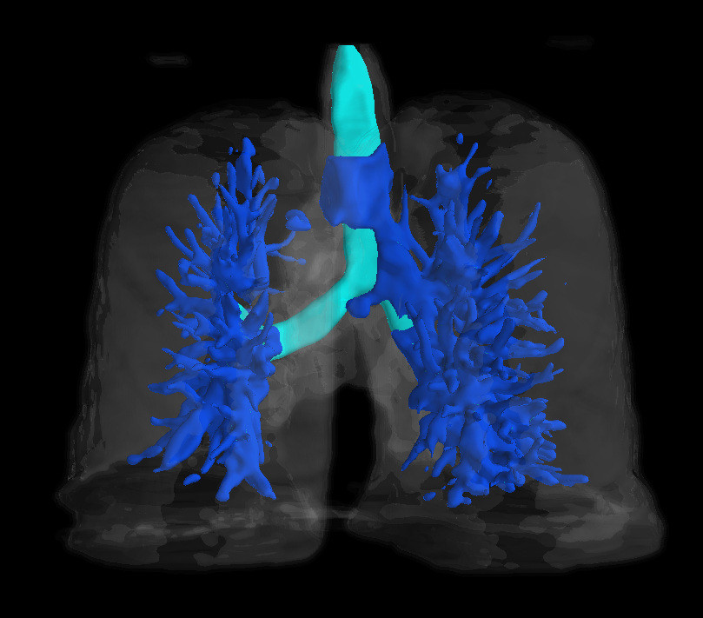
Meshlab Mayavi Modeling
Patient 1
Patient 2
Patient 3

Slide 17
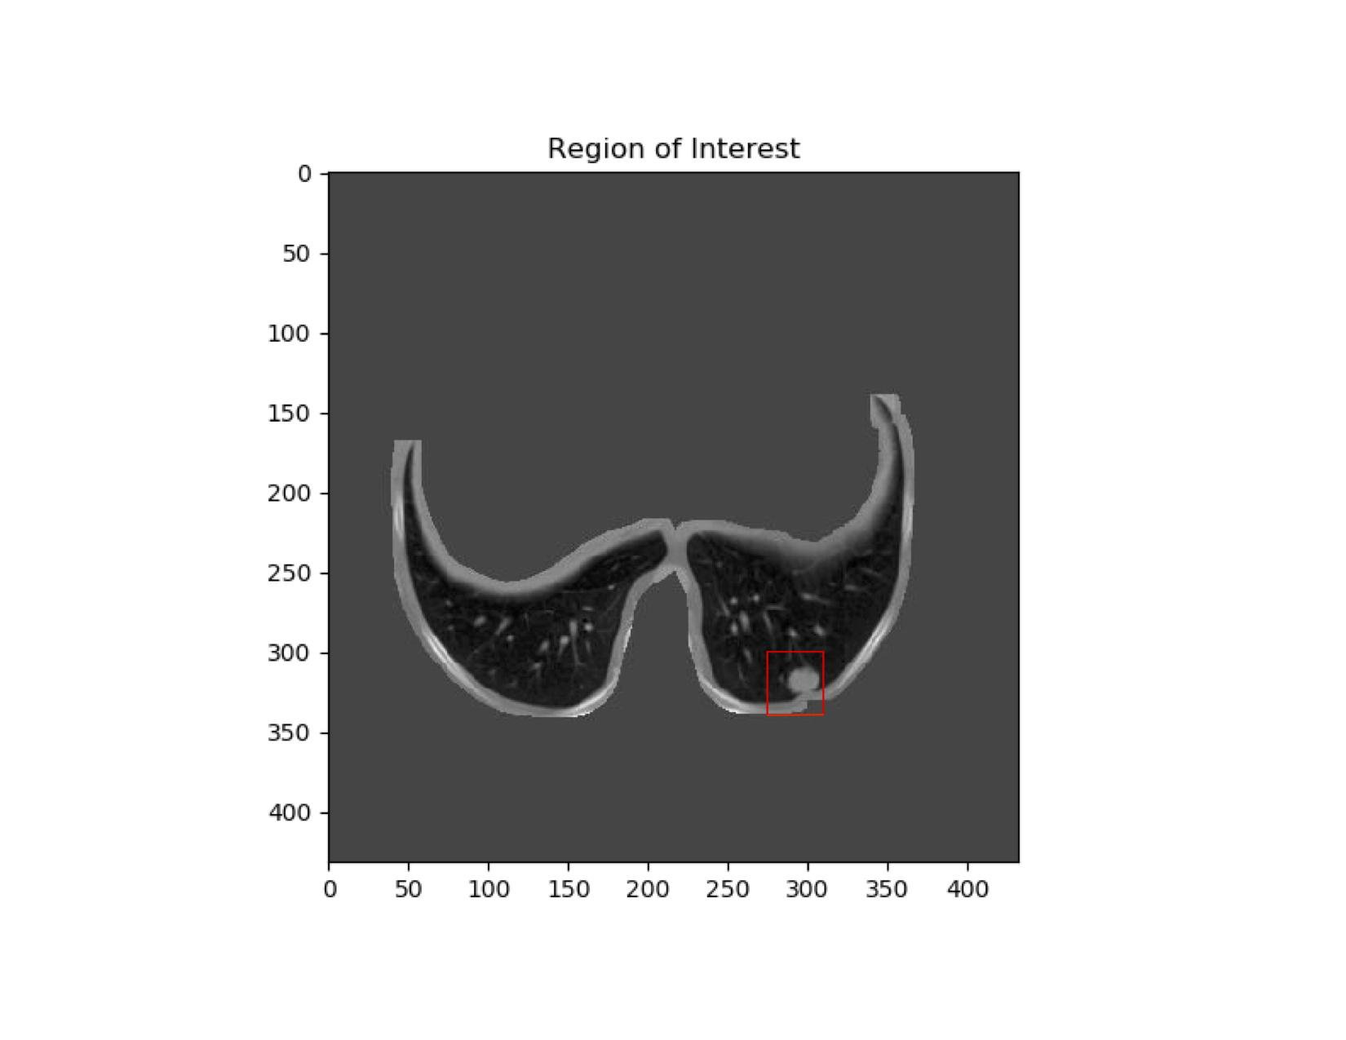
Segment Region of Interest
Input slice number and 2 coordinates to form box (shown in red) of patient 1

Slide 18
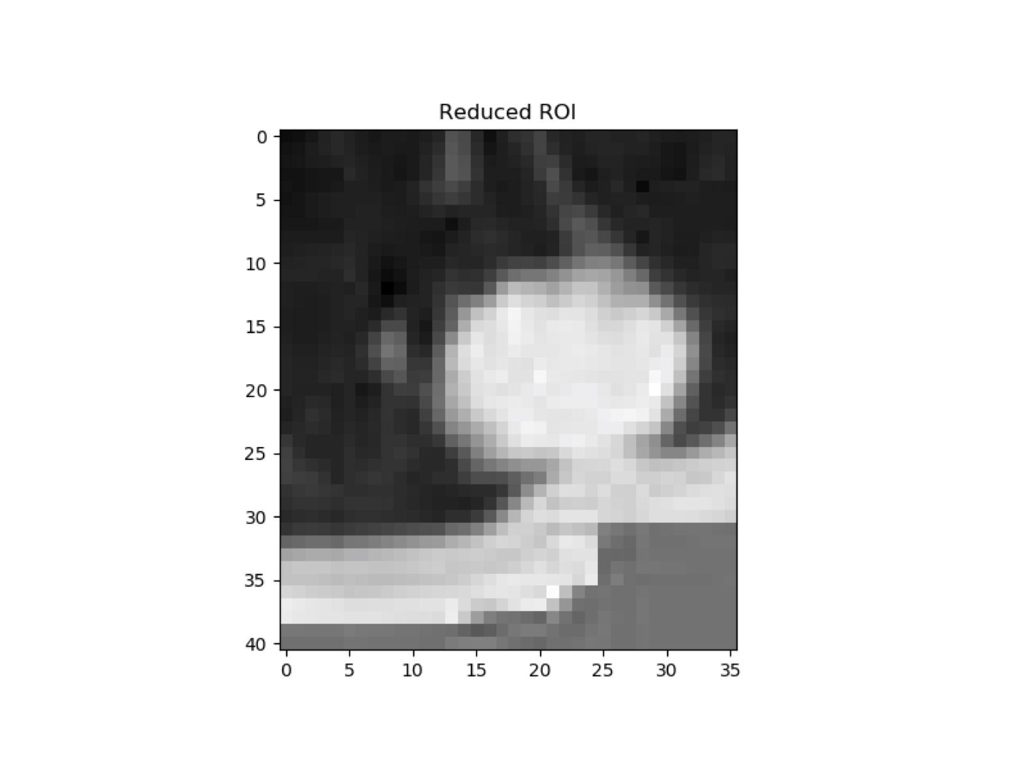
Segment Region of Interest
Input slice number and 2 coordinates to form box (shown in red)

Slide 19
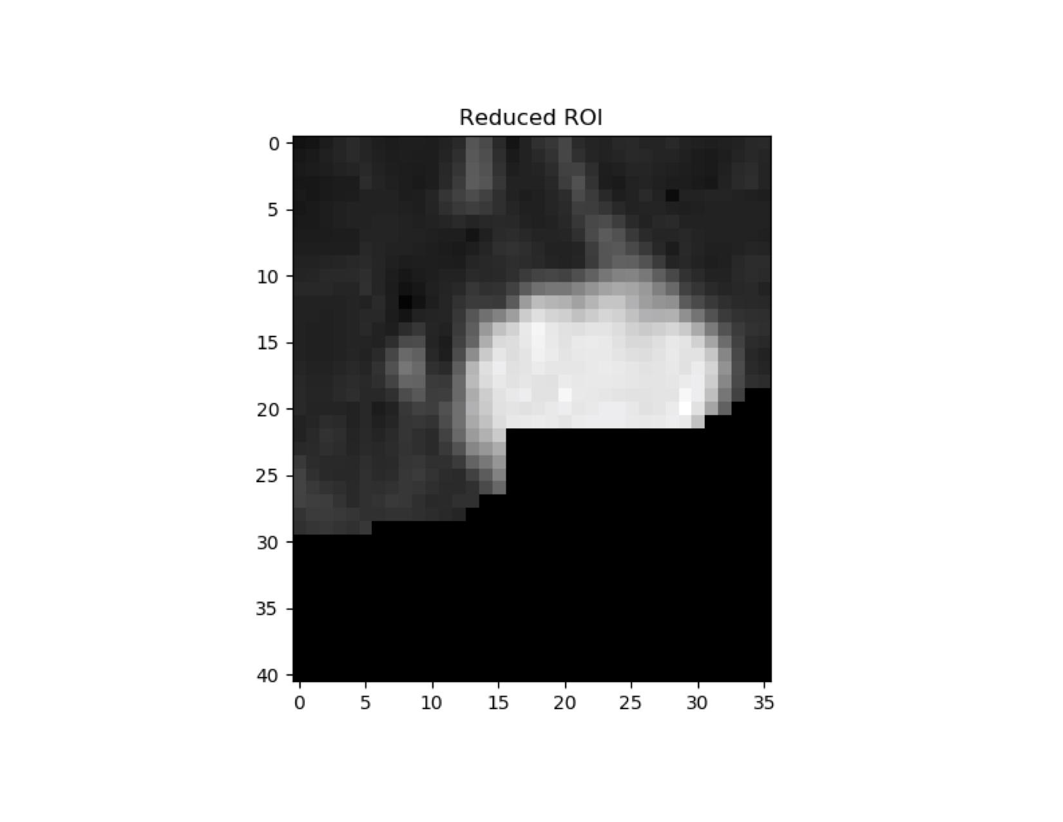
Segment Region of Interest
Input slice number and 2 coordinates to form box (shown in red)

Slide 20
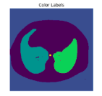
Segment Region of Interest
Input slice number and 2 coordinates to form box (shown in red)
When segmenting the lungs, an object that touches the walls of the lung may affect the dilation of the lung mask
Current Problem

Slide 21

Segment Region of Interest
Threshold of ROI

Slide 22
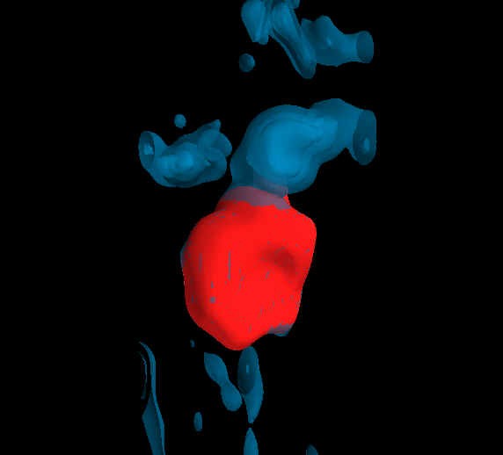
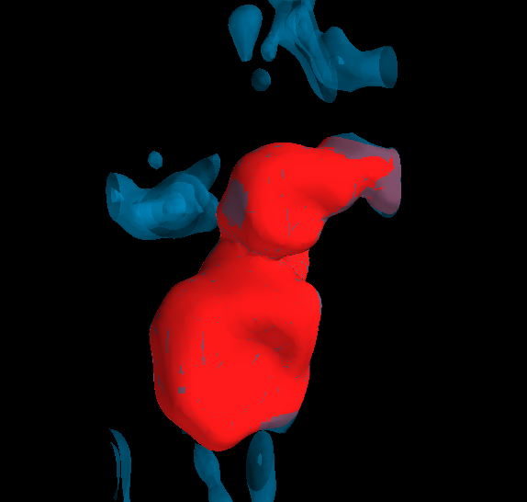
Segment Region of Interest
Calibrating large region growing algorithm
Threshold of ROI
Region Grow

Slide 23
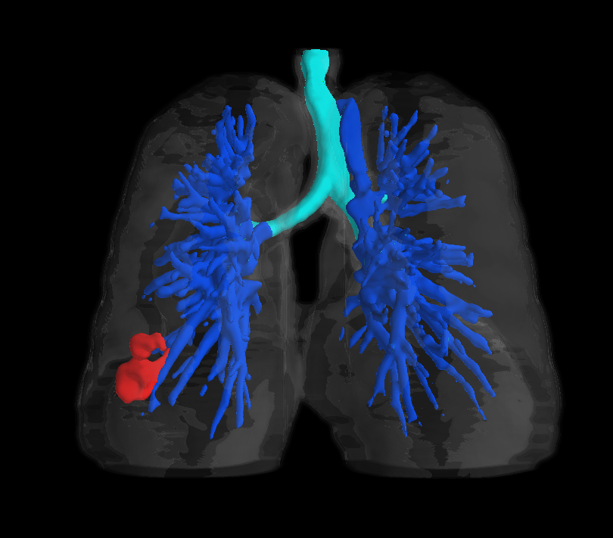
Segment Region of Interest
Threshold of ROI
Modeled with Lungs
Region Grow

Slide 24
Future Strategy

Slide 25
Future Steps
Improve quality of region growing algorithm. (Use Hounsfield units)
Properly separate objects that are close to the walls of the lung. Rolling ball algorithm or others
Begin machine vision approach for automatically defining regions of interest

Slide 26
Image Sources and Citations
Clark K, Vendt B, Smith K, et al. The Cancer Imaging Archive (TCIA): Maintaining and Operating a Public Information Repository. Journal of Digital Imaging. 2013; 26(6): 1045-1057. doi: 10.1007/s10278-013-9622-7.
Chen Howard, Radiology Data Quest, https://www.raddq.com/dicom-processing-segmentation-visualization-in-python/
Ramadan, Zayed M. “Optimum Image Filters for Various Types of Noise.” Telkomnika, vol. 16, no. 5, Oct. 2018, pp. 2458–2464. EBSCOhost, doi:10.12928/TELKOMNIKA.v16i5.10508.
Rˆomulo Pinho, Sten Luyckx, and Jan Sijbers, Robust Region Growing Based Intrathoracic Airway Tree Segmentation, University of Antwerp, Physics Department, VisionLab, Belgium
https://en.wikipedia.org/wiki/Microelectromechanical_systems
https://case.edu/emails/engineering/SDLE_Grand_Opening.html
https://www.bandsintown.com/e/17356503-time-cat-at-wruw-fm-91.1

Slide 27
Thank you for your time

Slide 28
Extra slides

Slide 29

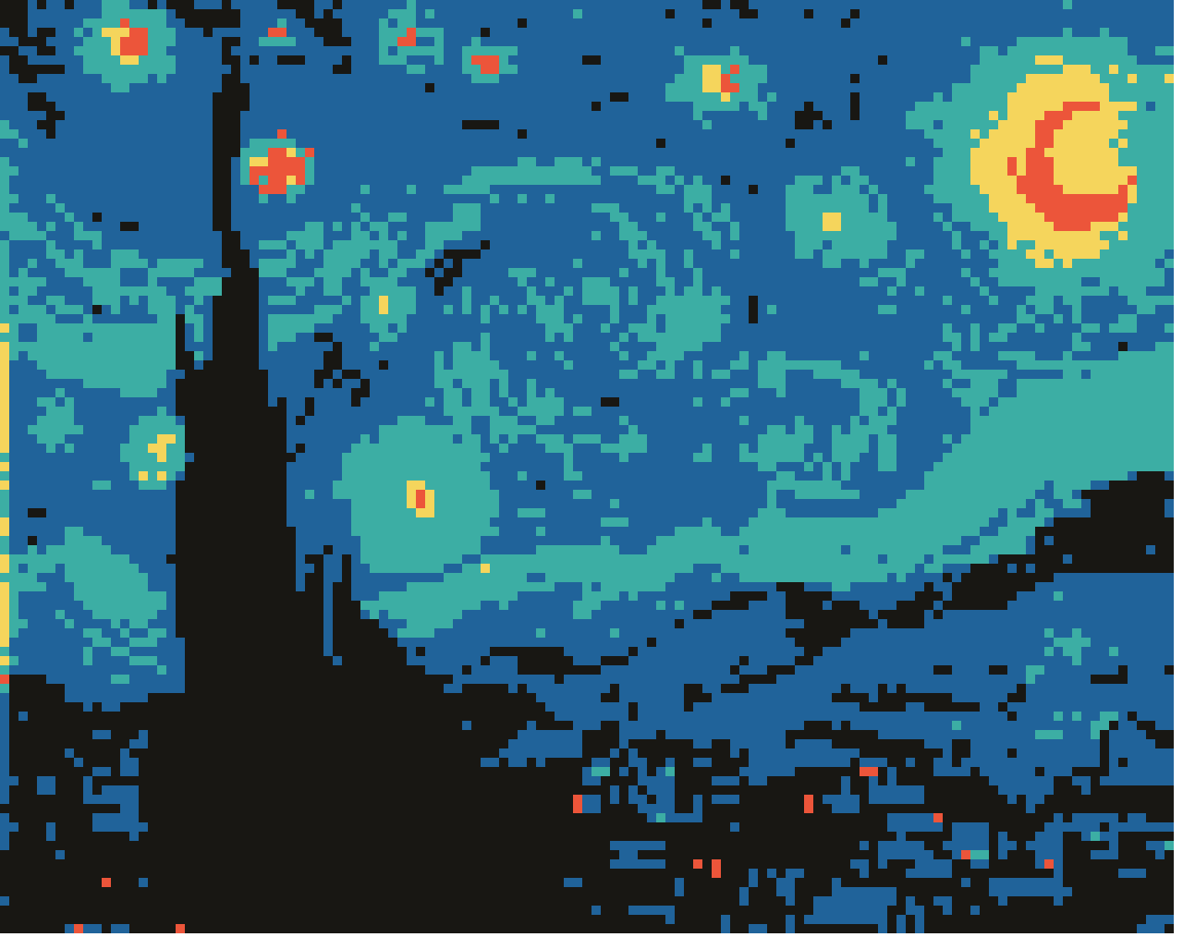
My Background
Coding Background
Recently revisited Java for a personal project: Pixelated Impressionism

Slide 30


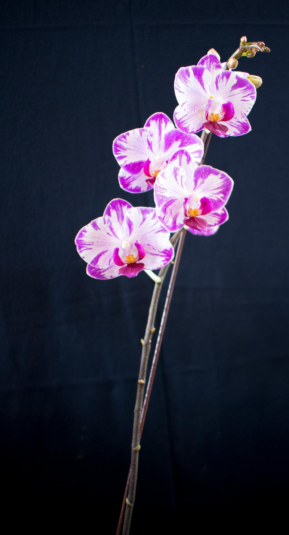
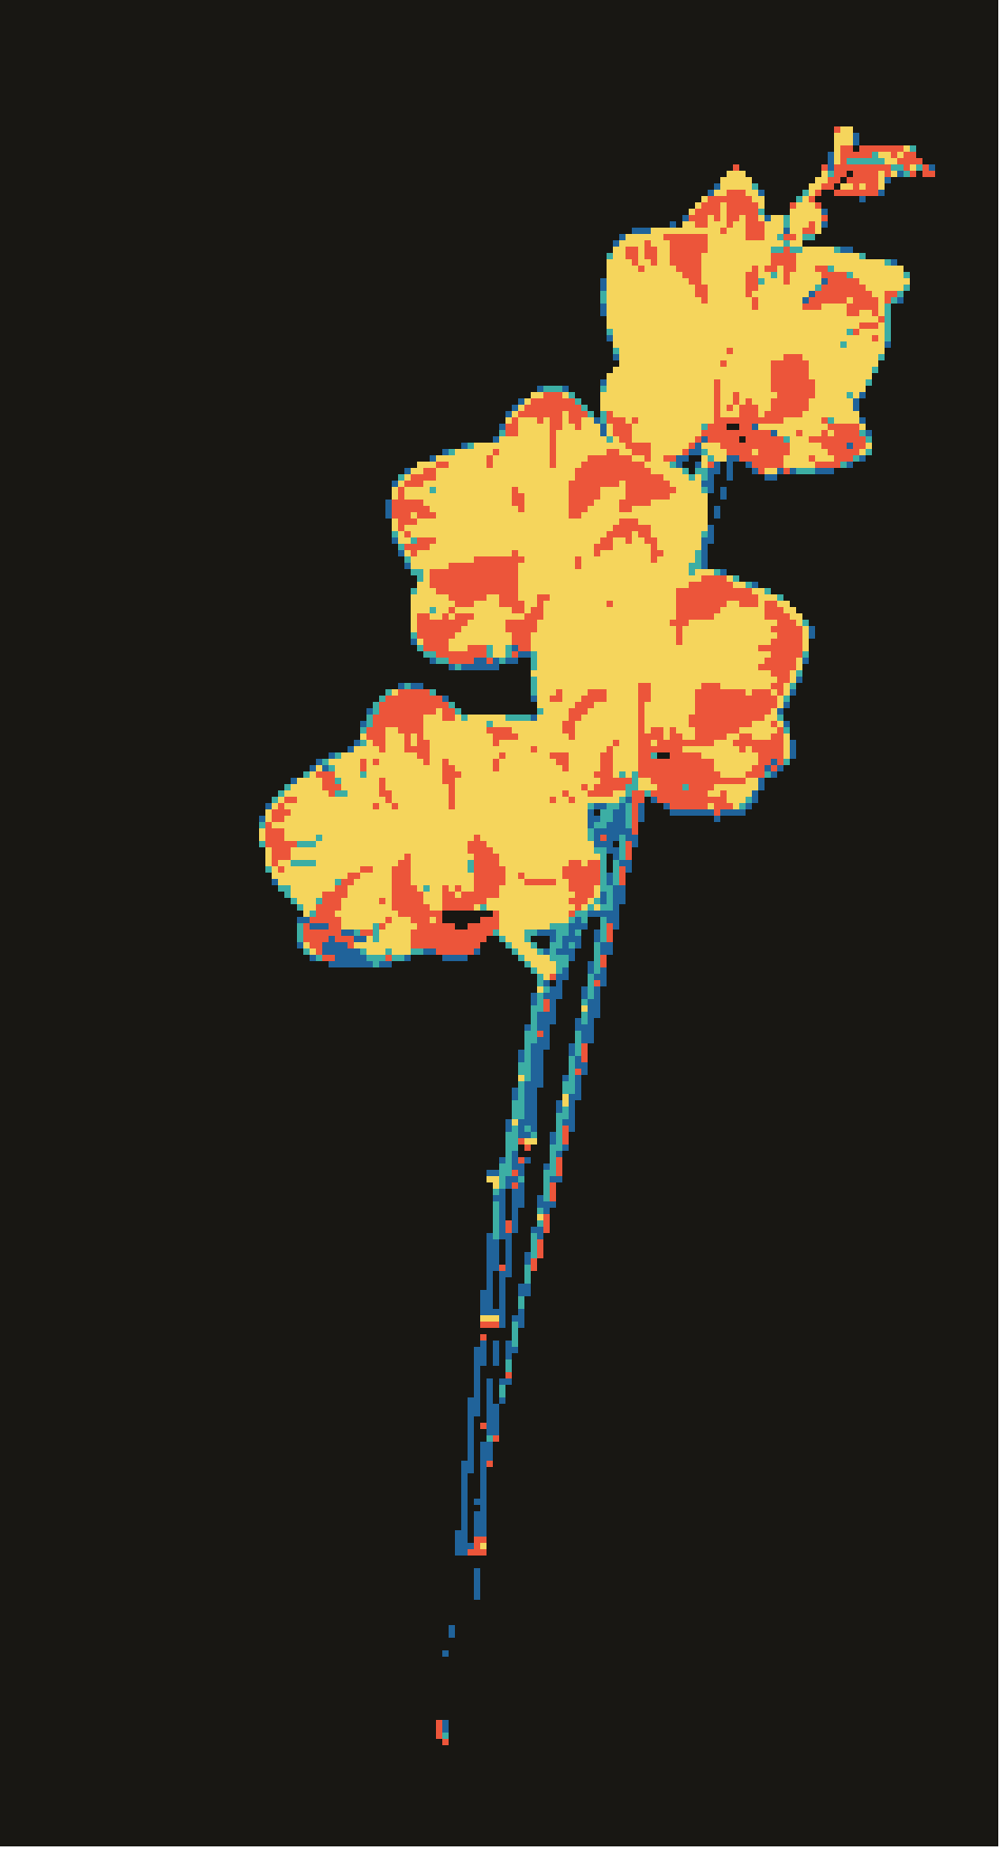

Slide 31
Airway Segmentation
Pixel count for each slice
Graph indicates number of pixels counted for each slice
Observe leaks before 3D plotting

Slide 32
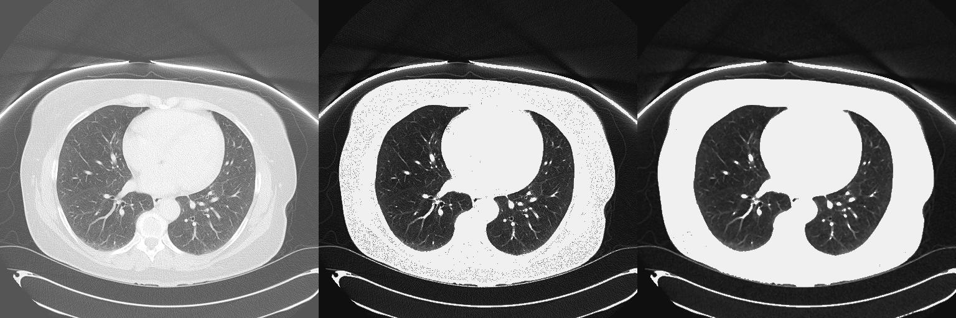
Image Processing: Filtering Images
Optimum Image Filters for Various Types of Noise.” Telkomnika, vol. 16, no. 5, Oct. 2018
Gaussian Noise
Speckle Noise
Salt and Pepper Noise
Poisson Noise
Original
Pointwise Transformation
Median Filter

Slide 33
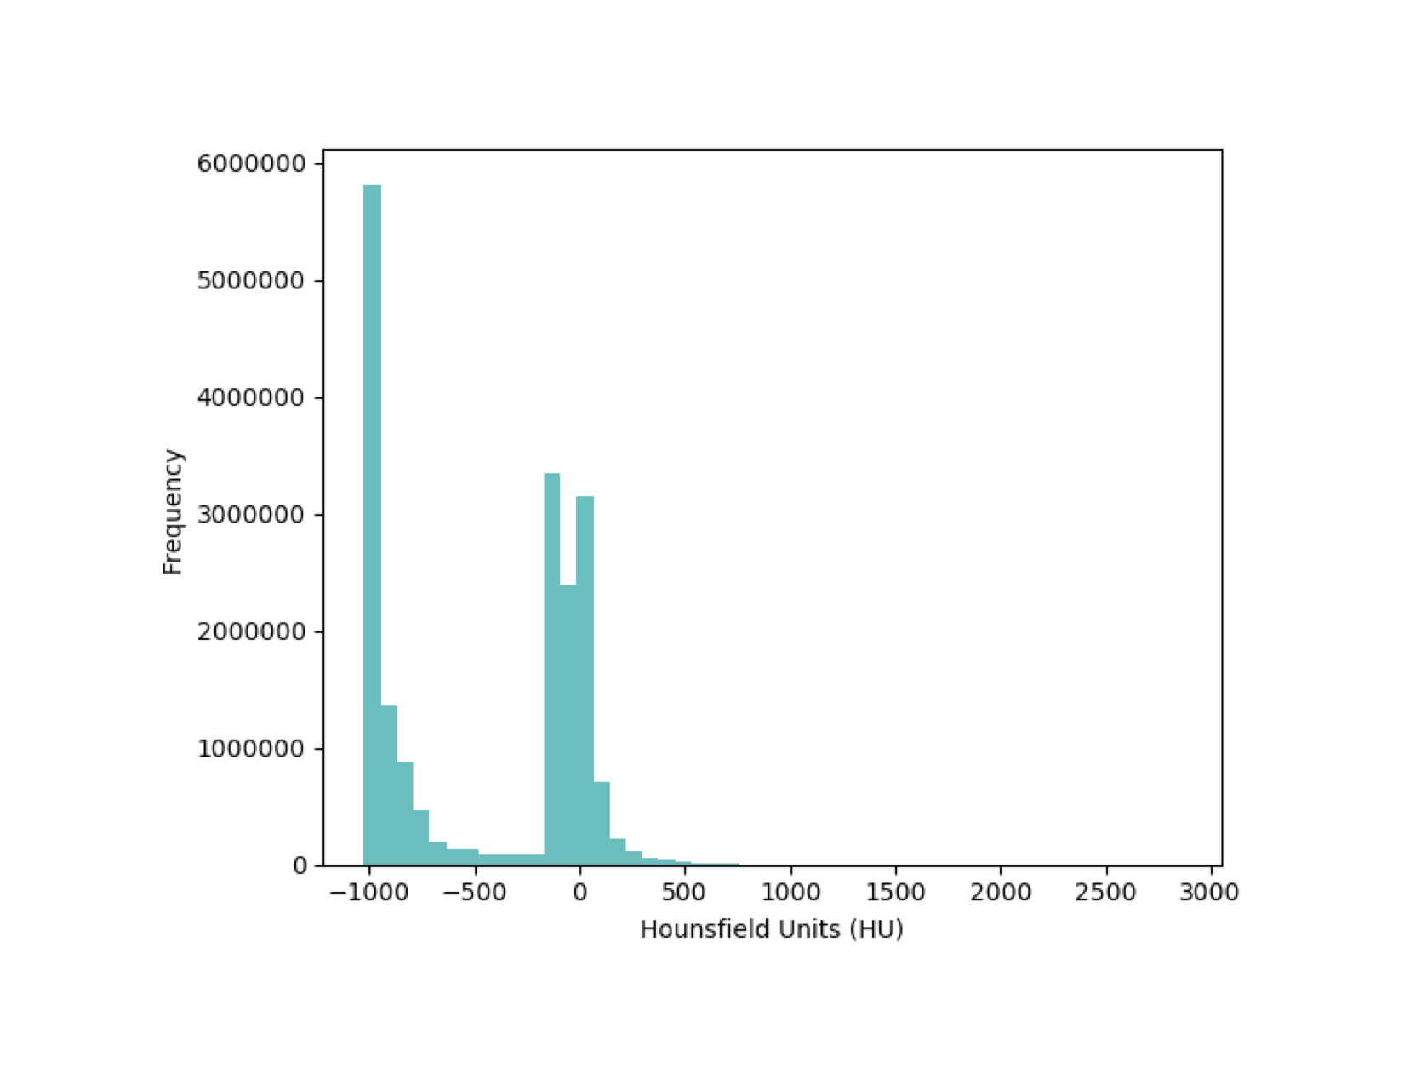
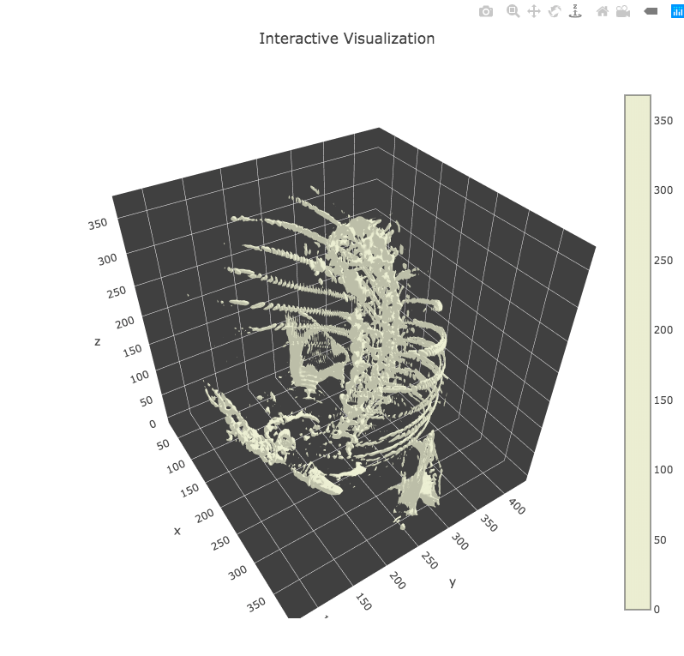
Image Processing: Process DICOM Files
The Cancer Imaging Archive (TCIA)
Histogram
3D-Plot

